Slide 1
[weekly Report ]
Researching Project
“ Soil Ph meter Design ”
Lecturer: Hel Chanthan
By: Nhim ChanRengSey
2020-2021

Slide 2
Outline
STM32F103C8TX
STM32CUBEide:
Configure
Use
STM32F1 & Components
DHT22 Communication
DHT22’s Data Transmission

Slide 3
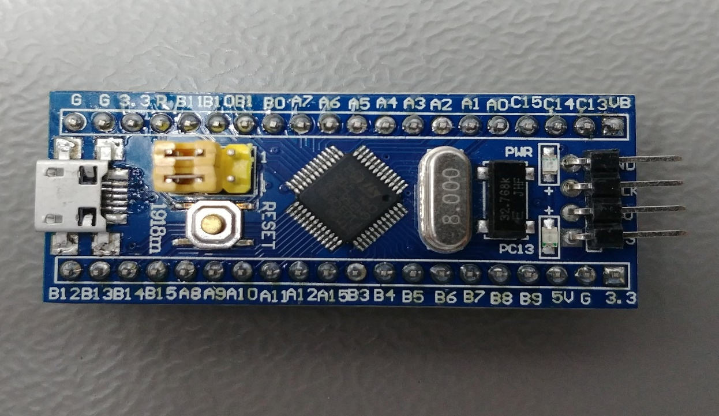
STM32F103C8T6(Blue Pill)
Boot Selector
Power LED
Micro USB
SWD Interface
Reset Button
User LED (PC13)
STM32F103C8T6 MCU
LSE 32.768kHz
HSE 8MHz
Page:01

Slide 4
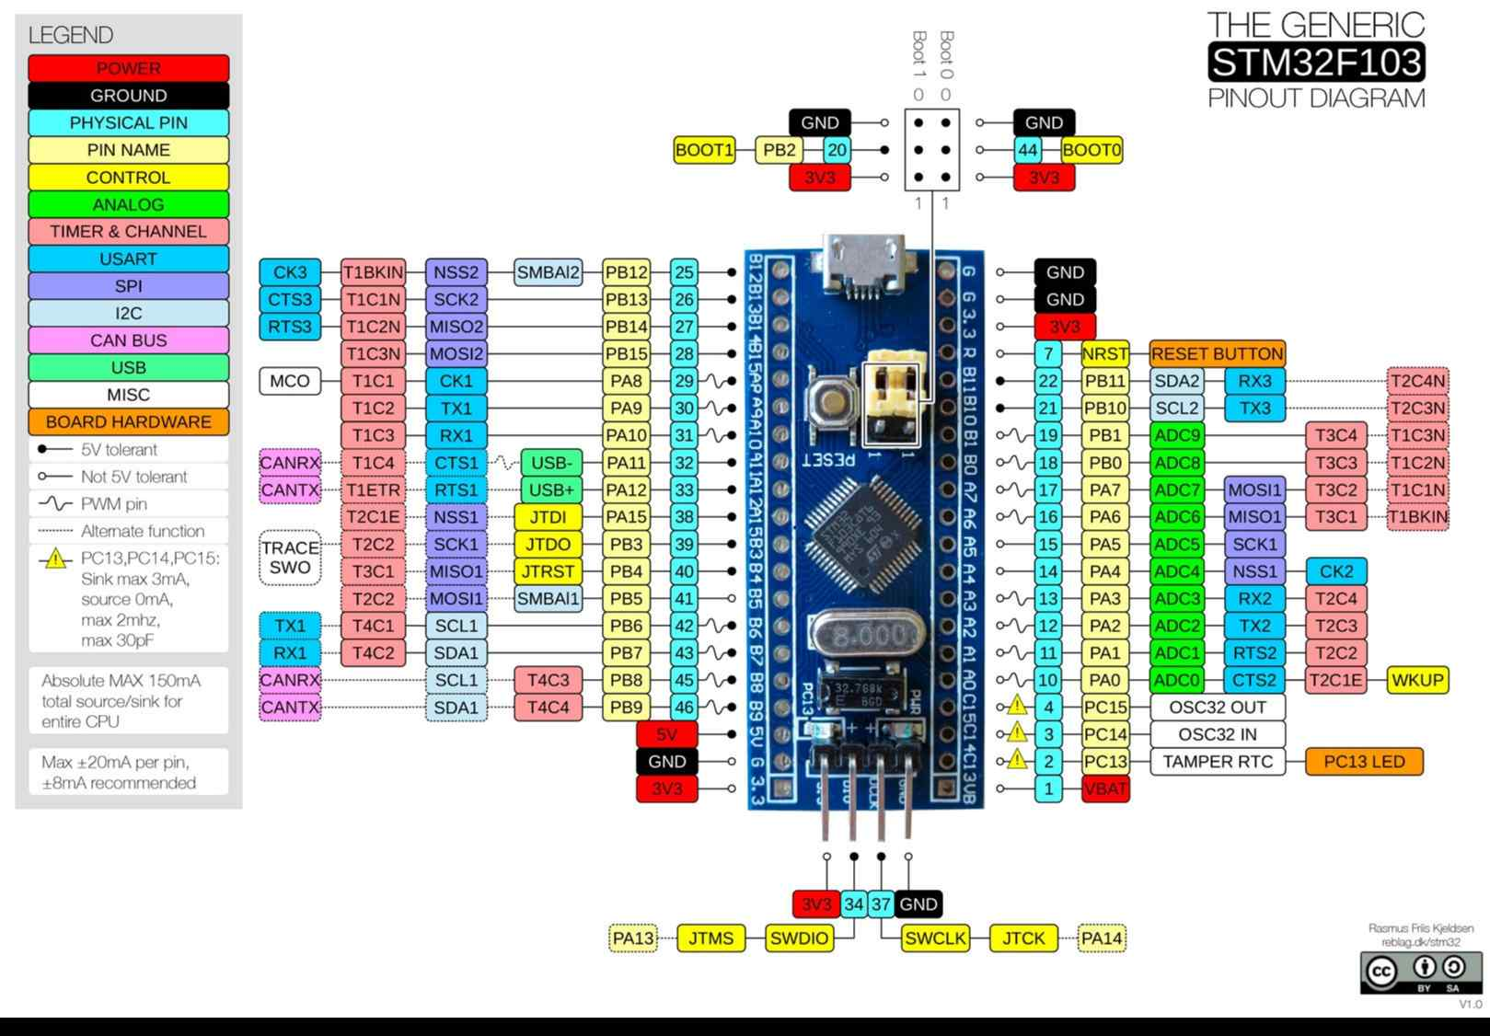
Page:02

Slide 5
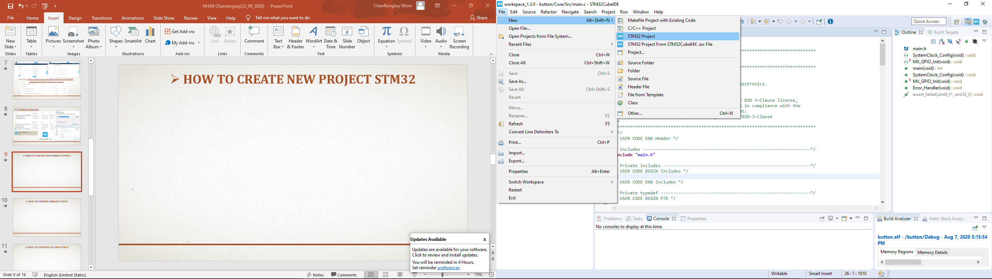
STM32Cube Ide
Configure
Page:03

Slide 6
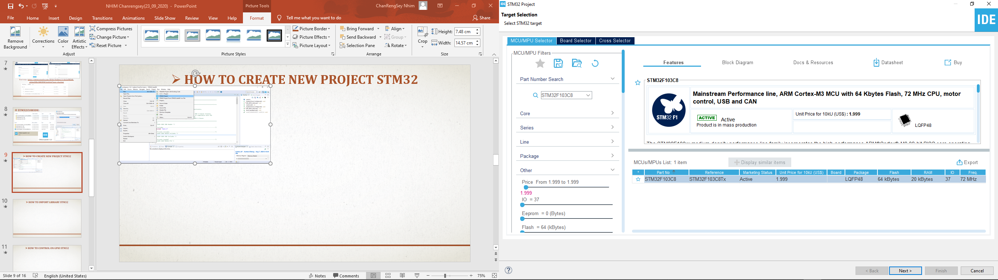
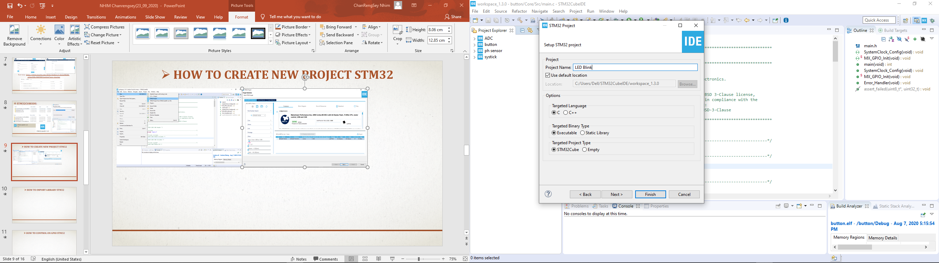
STM32Cube Ide
Page:04

Slide 7
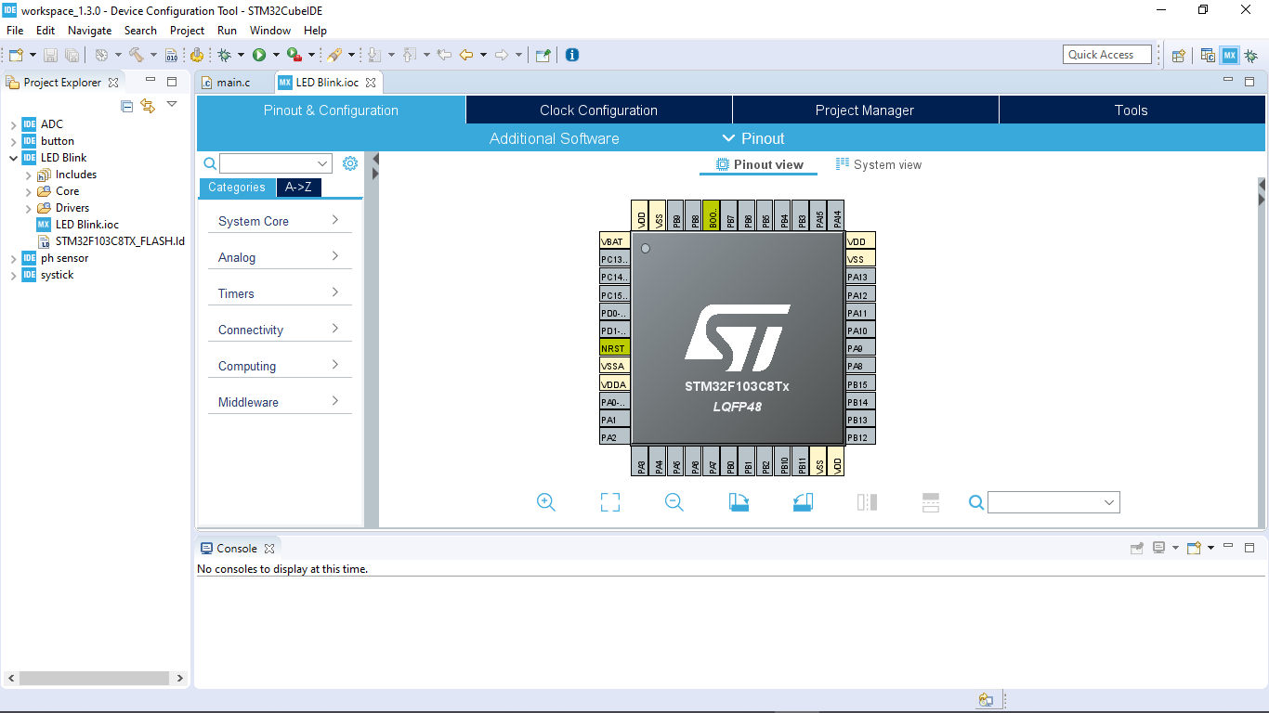
STM32Cube Ide
Page:05

Slide 8
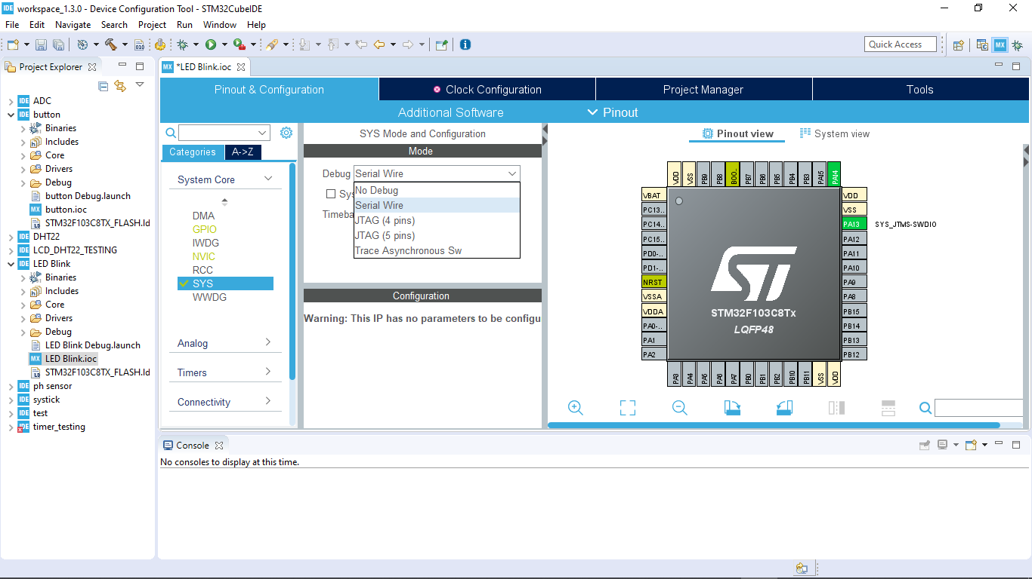
STM32Cube Ide
Page:06

Slide 9
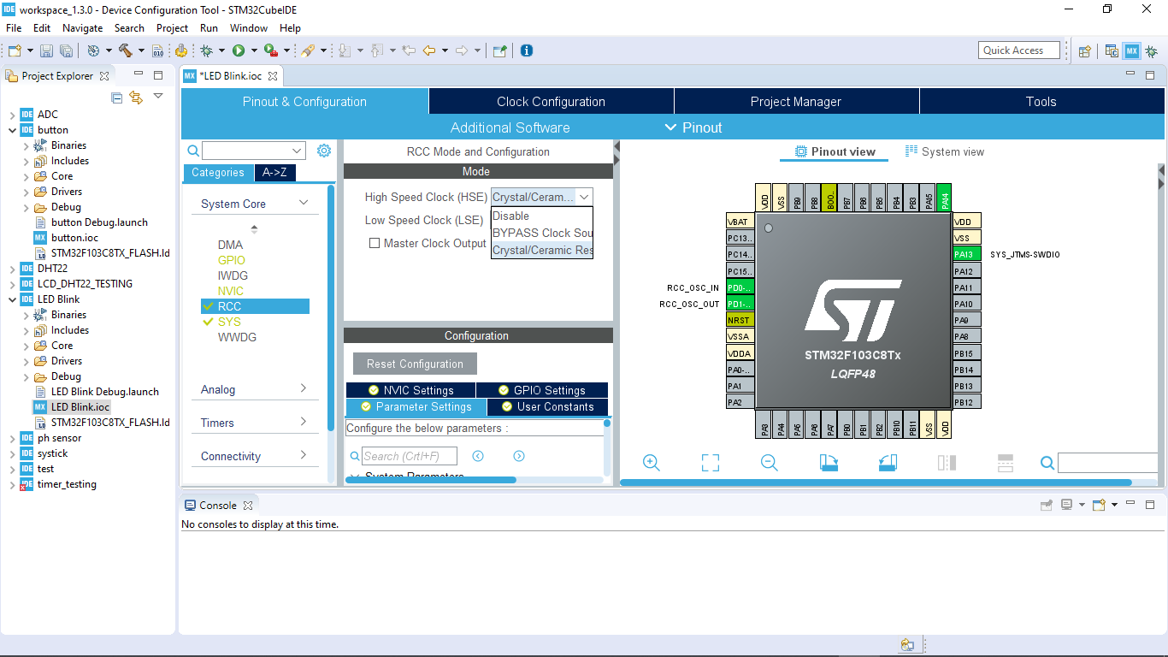
STM32Cube Ide
Page:07

Slide 10
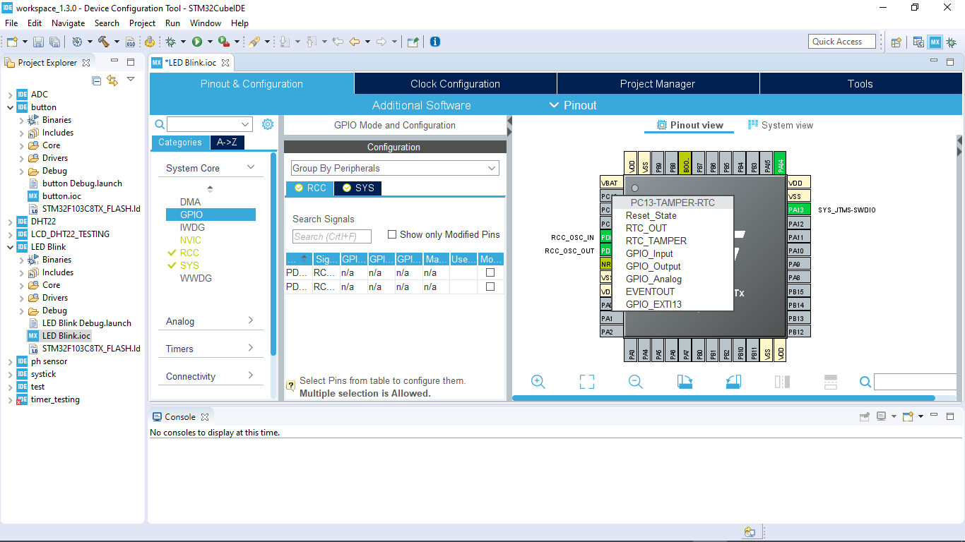
STM32Cube Ide
Page:08

Slide 11
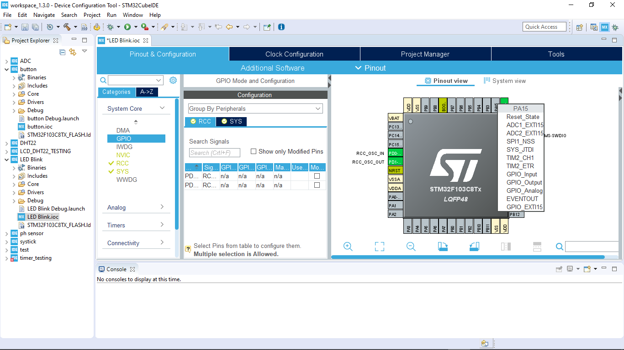
STM32Cube Ide
Page:09

Slide 12
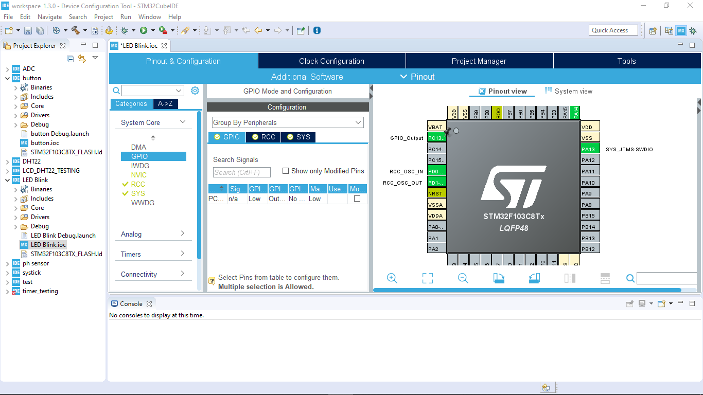
STM32Cube Ide
Page:10

Slide 13
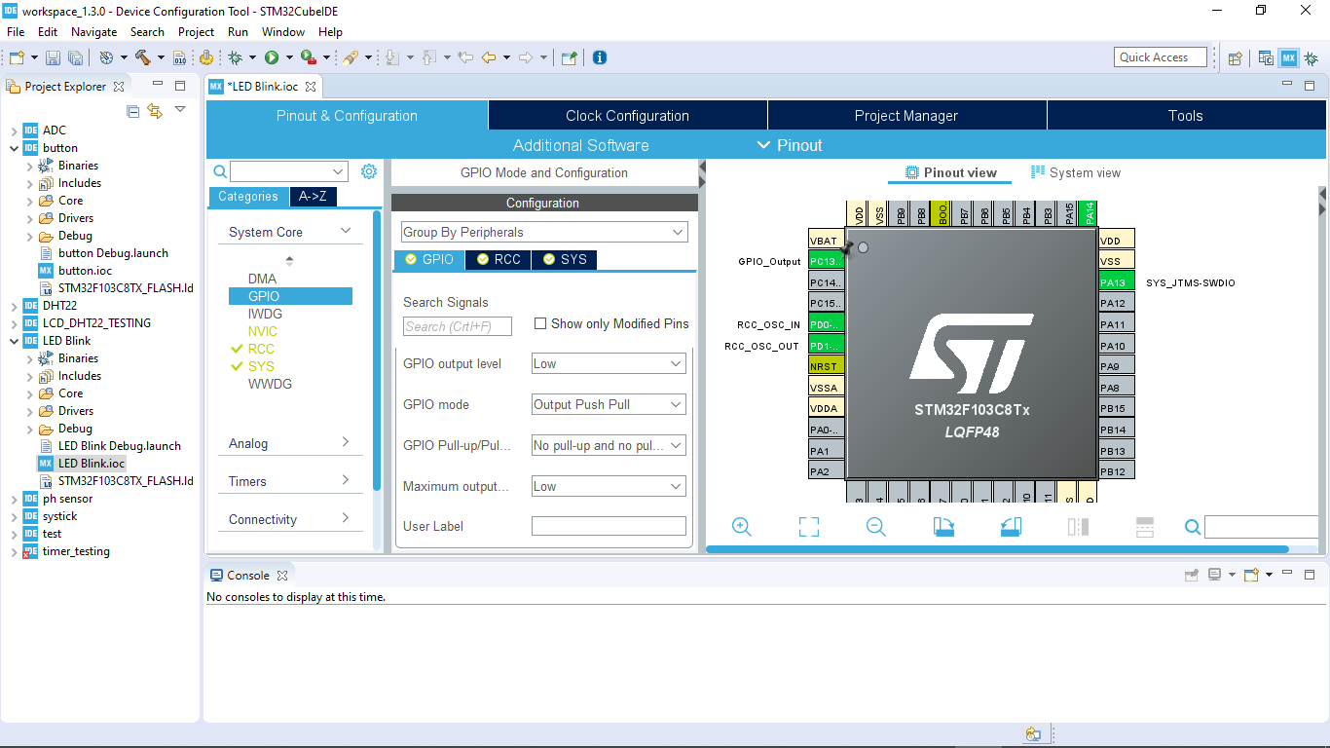
STM32Cube Ide
Page:11

Slide 14

STM32Cube Ide
Page:12

Slide 15

STM32Cube Ide
Page:13

Slide 16
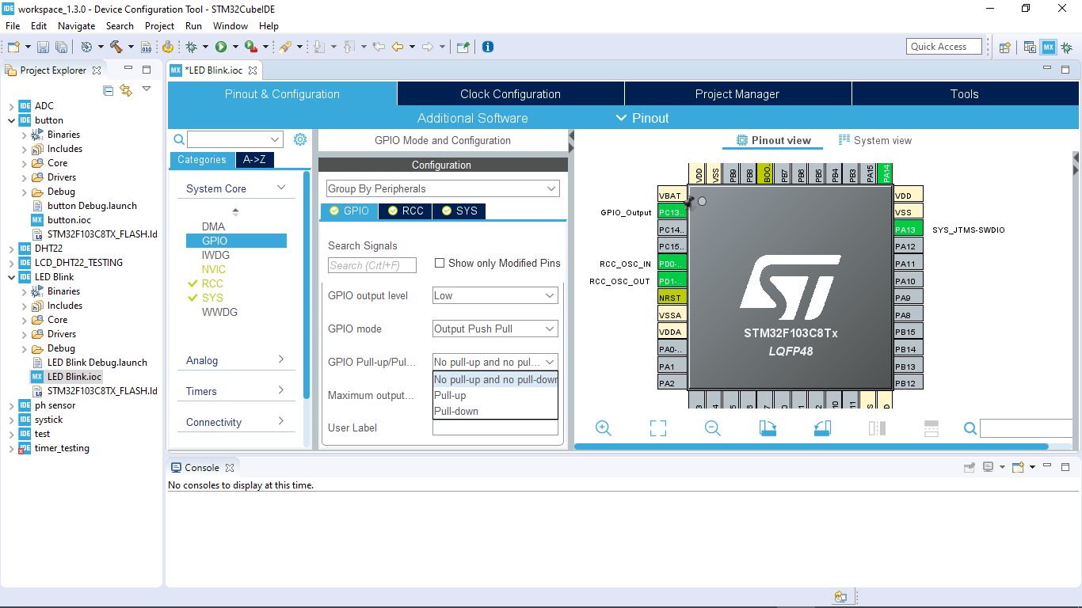
STM32Cube Ide
Page:14

Slide 17
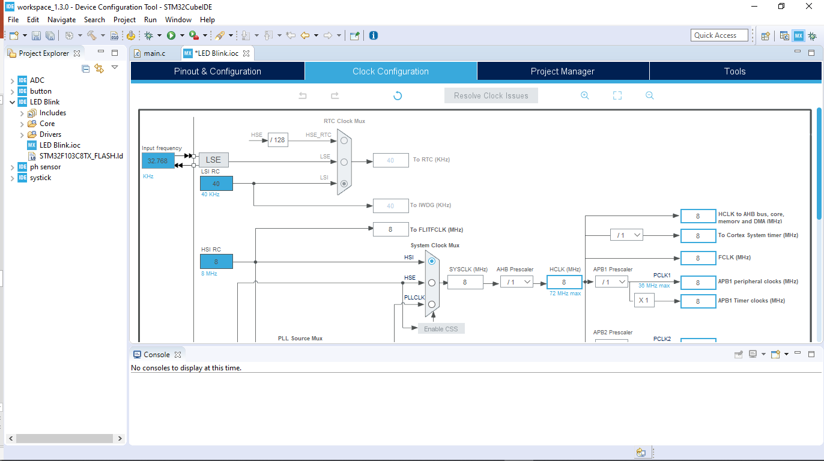
STM32Cube Ide
Page:15

Slide 18
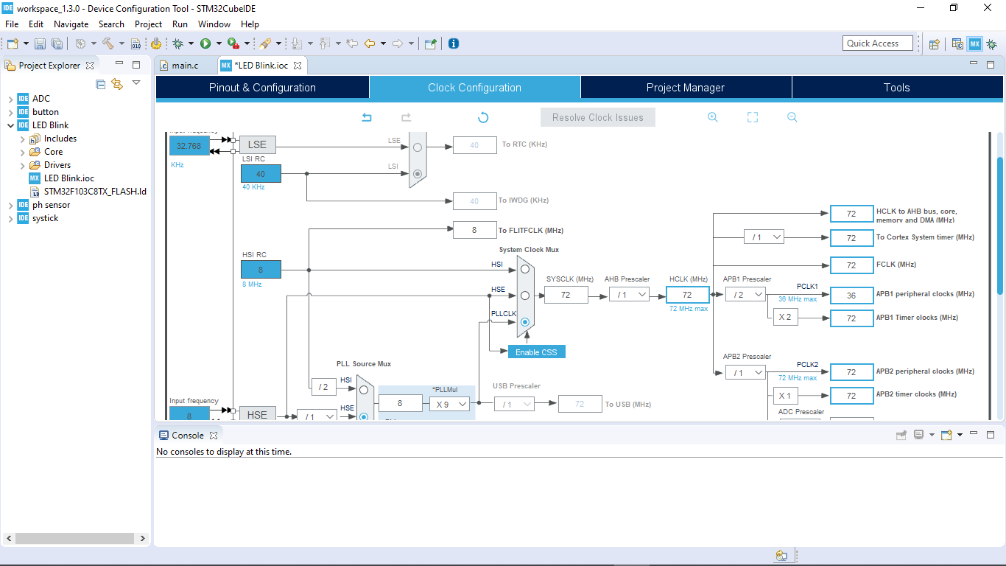
STM32Cube Ide
Page:16

Slide 19
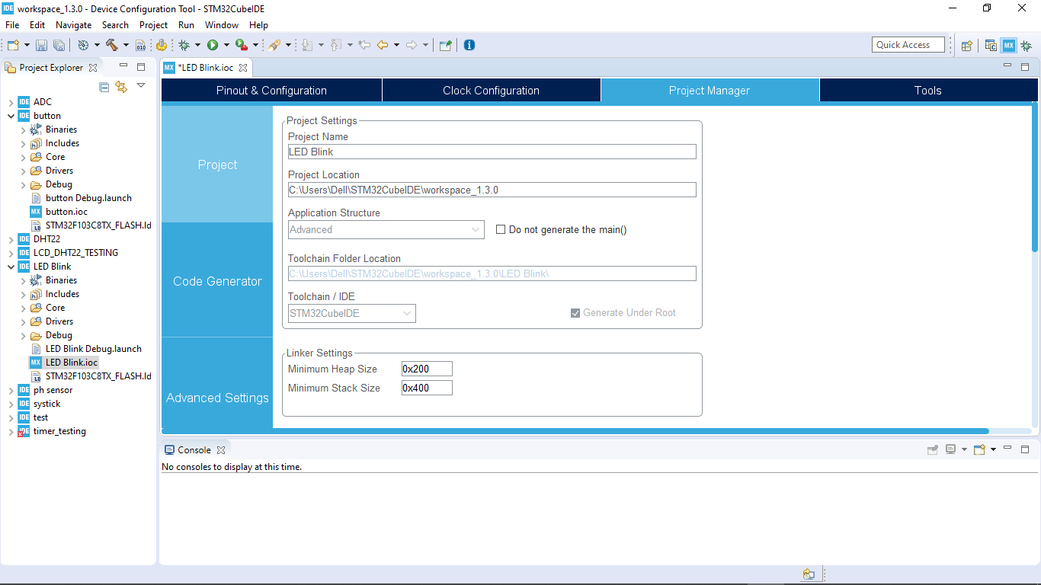
STM32Cube Ide
Page:17

Slide 20
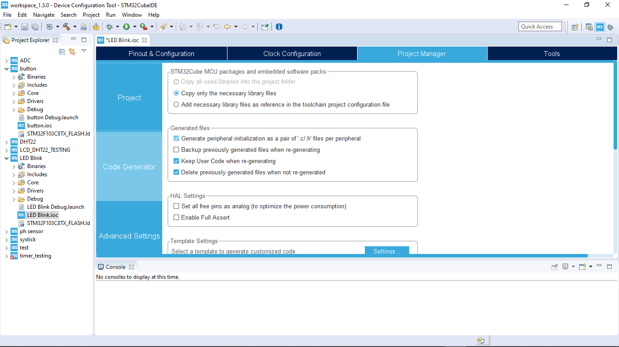
STM32Cube Ide
Page:18

Slide 21
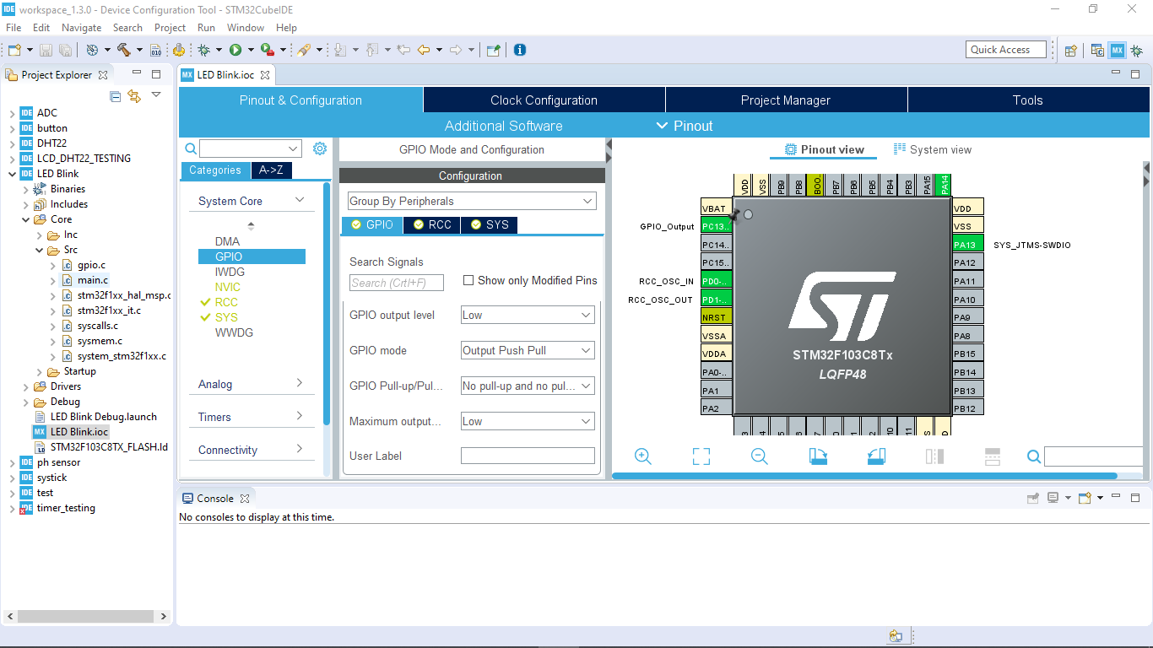
STM32Cube Ide
Page:19

Slide 22
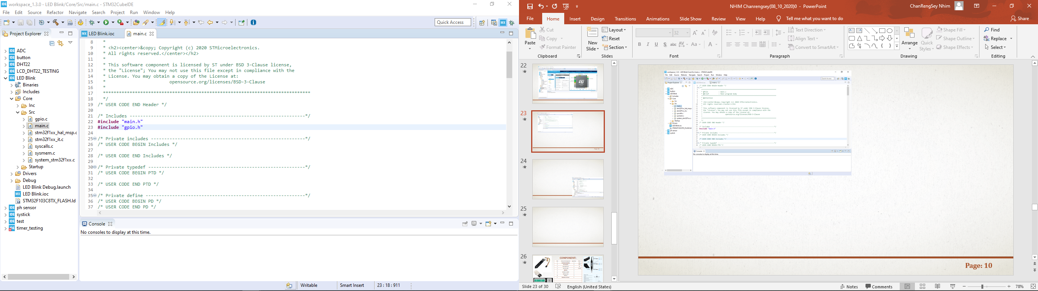
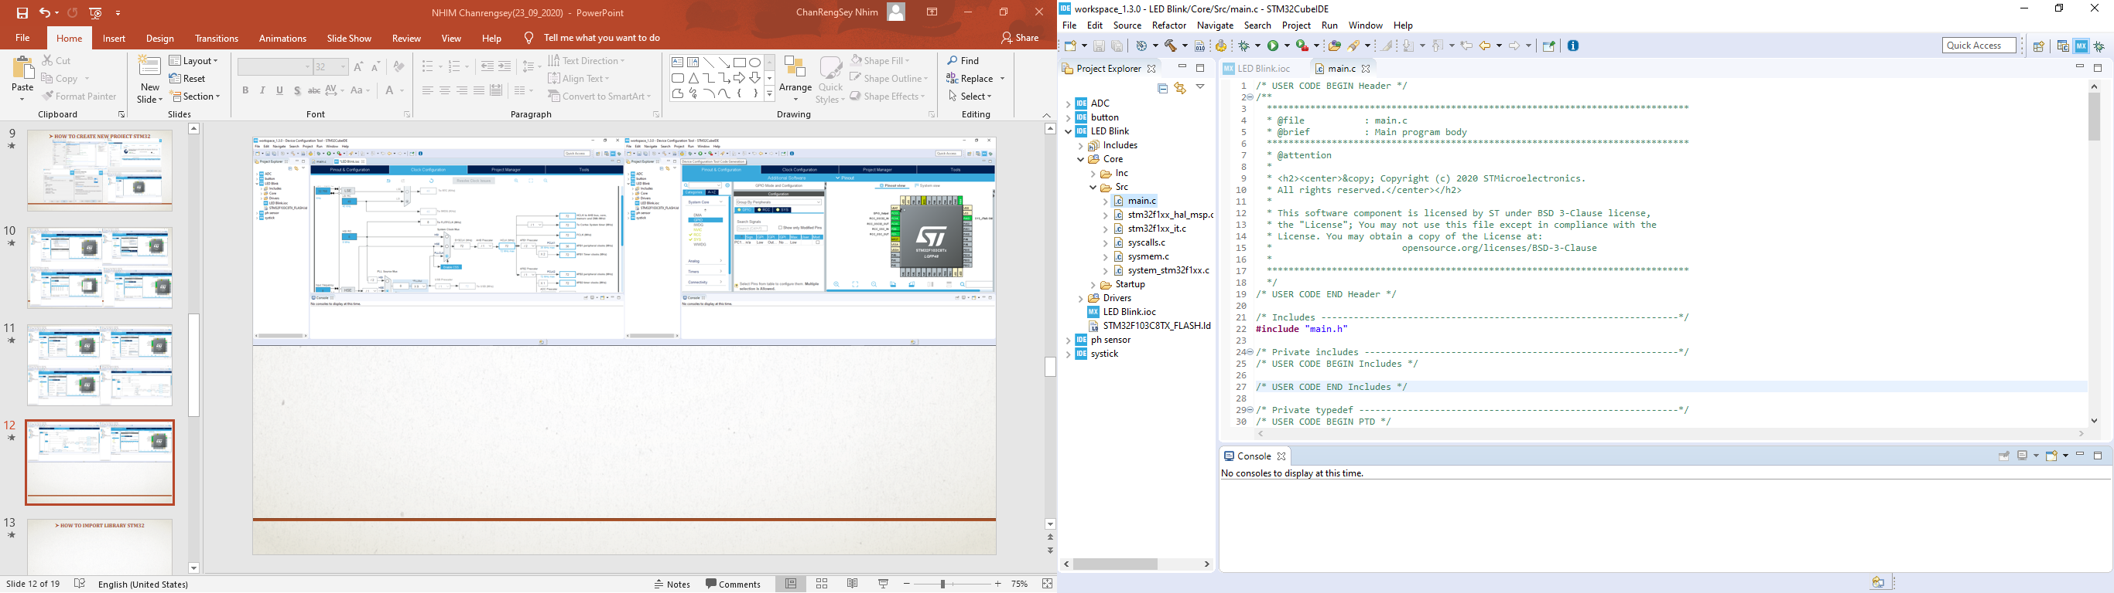
STM32Cube Ide
Page:20

Slide 23
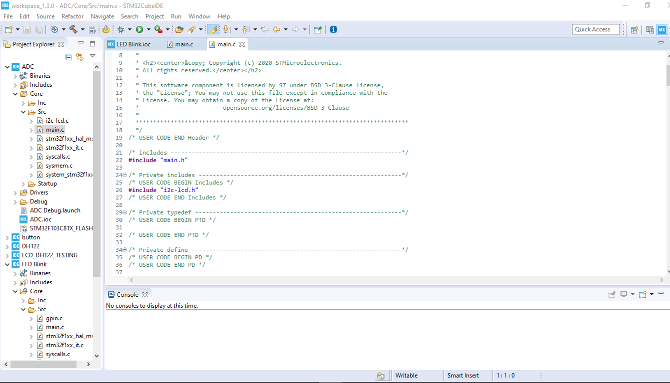
STM32Cube Ide
Page:21

Slide 24
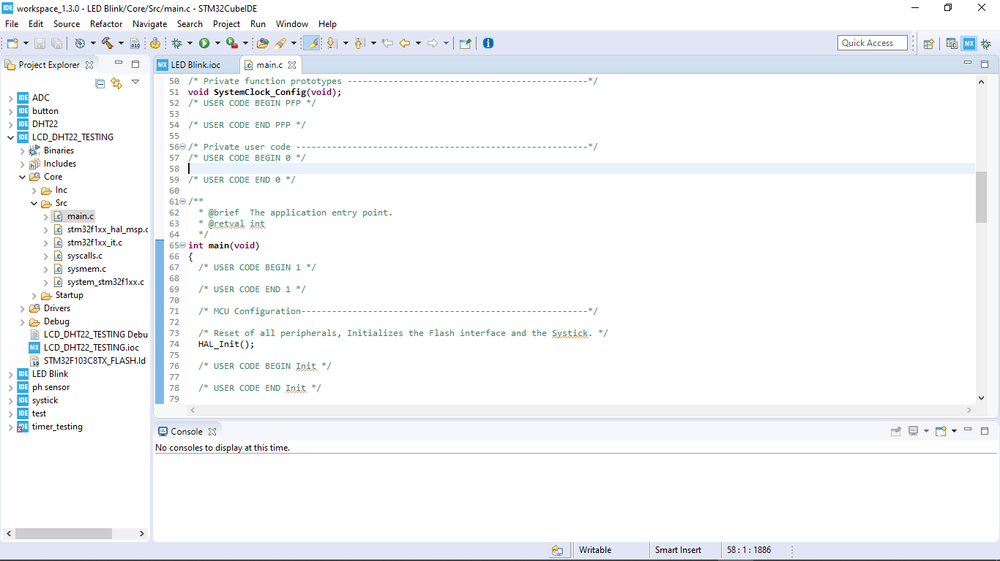
STM32Cube Ide
Page:22

Slide 25
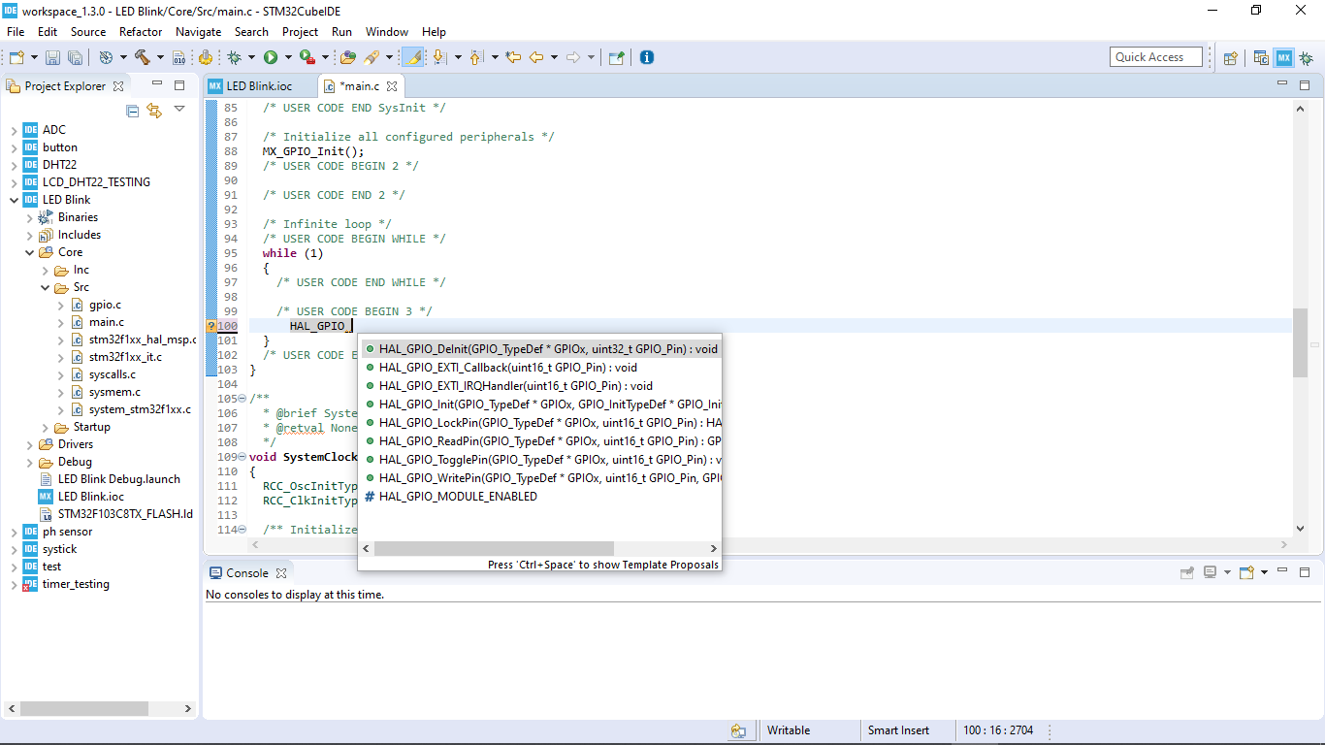
STM32Cube Ide
Page:23

Slide 26
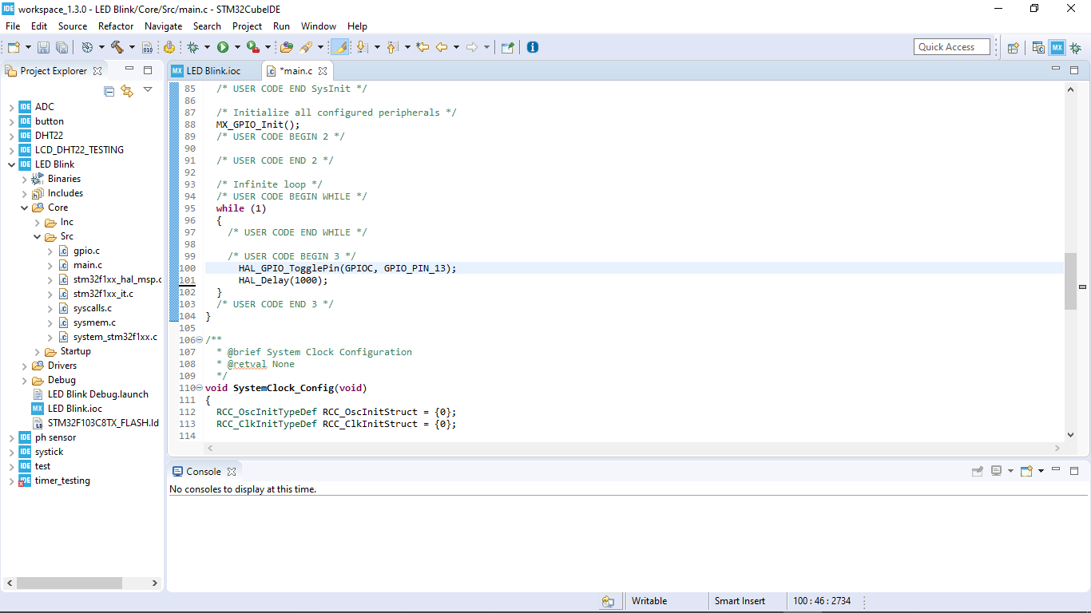
STM32Cube Ide
Page:24

Slide 27
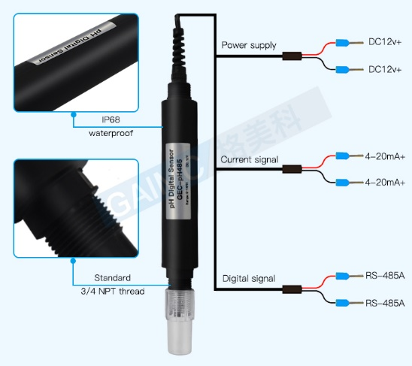
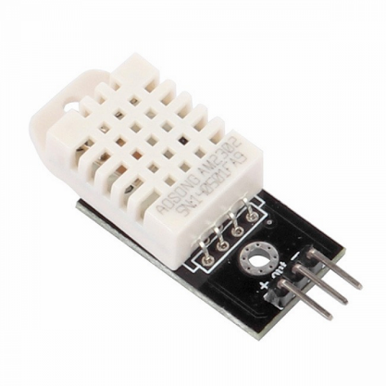
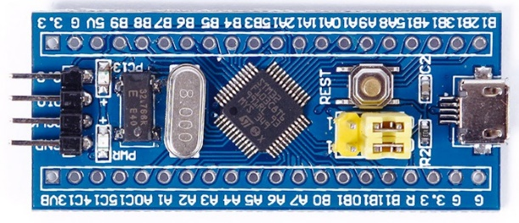
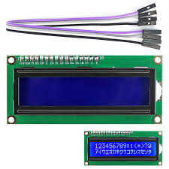
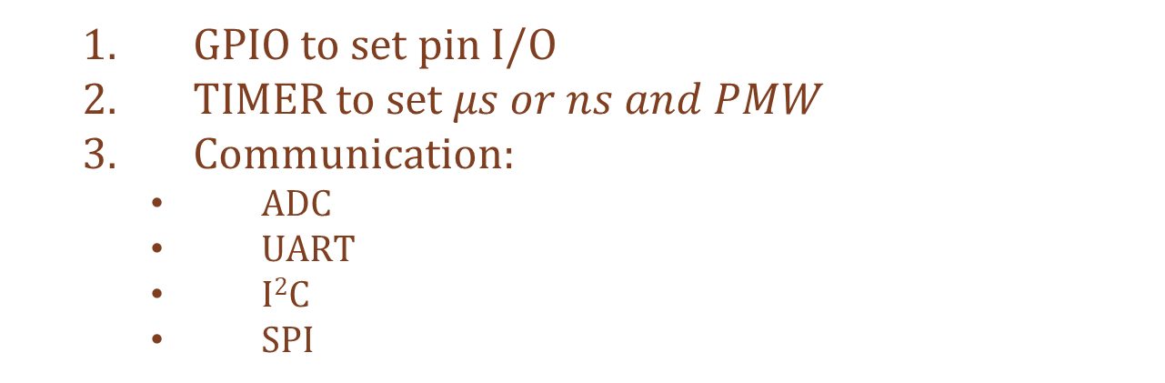
STM32F1 MCU & Components
GPIO to set pin I/O
TIMER to set $μs or ns and PMW$
Communication:
ADC
UART
I²C
SPI
ADC (Analog)
RS485 to UART
(UART)
Micro-Controller
I²C
Single-bus
Page:25

Slide 28
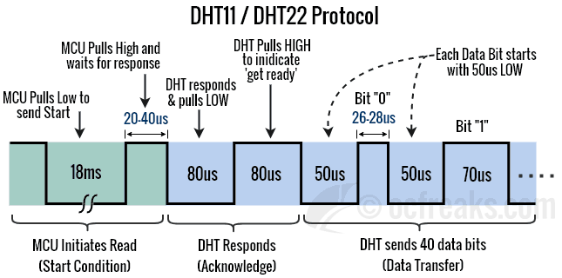
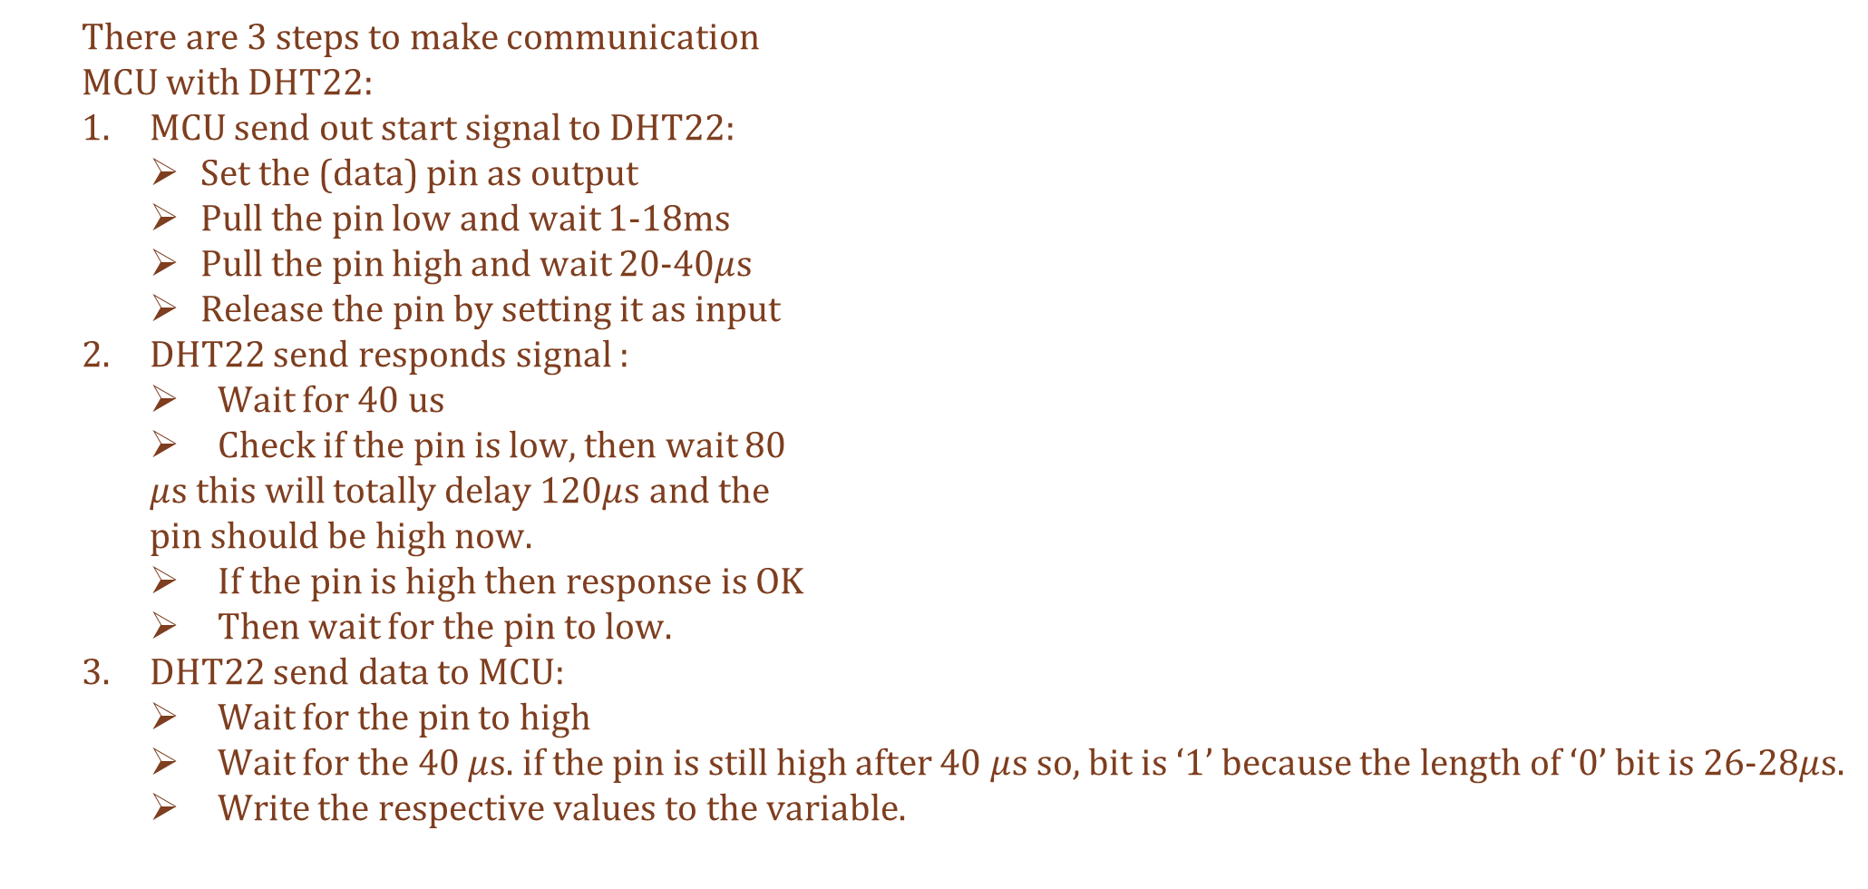
DHT22 Communication
There are 3 steps to make communication
MCU with DHT22:
MCU send out start signal to DHT22:
Set the (data) pin as output
Pull the pin low and wait 1-18ms
Pull the pin high and wait 20-40$μ$s
Release the pin by setting it as input
DHT22 send responds signal :
Wait for 40 us
Check if the pin is low, then wait 80
$μ$s this will totally delay 120$μ$s and the
pin should be high now.
If the pin is high then response is OK
Then wait for the pin to low.
DHT22 send data to MCU:
Wait for the pin to high
Wait for the 40 $μ$s. if the pin is still high after 40 $μ$s so, bit is ‘1’ because the length of ‘0’ bit is 26-28$μ$s.
Write the respective values to the variable.
Page:26

Slide 29
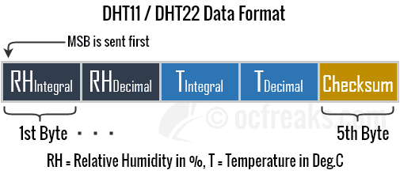
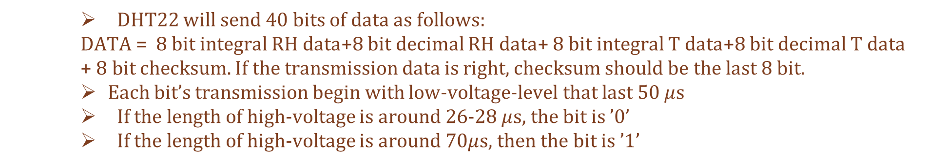
DHT22’s Data Transmission
DHT22 will send 40 bits of data as follows:
DATA = 8 bit integral RH data+8 bit decimal RH data+ 8 bit integral T data+8 bit decimal T data + 8 bit checksum. If the transmission data is right, checksum should be the last 8 bit.
Each bit’s transmission begin with low-voltage-level that last 50 $μ$s
If the length of high-voltage is around 26-28 $μ$s, the bit is ’0’
If the length of high-voltage is around 7$0μ$s, then the bit is ’1’
Page:27

Slide 30
THANK YOU

